Slide 1
OLS Assumptions
Rutgers Statistics Club
X
Cognitive Science Club

Slide 2
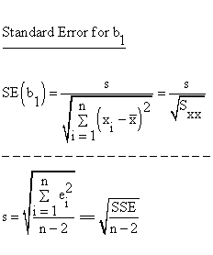
Hypothesis Testing Review
When testing y = β₀ + β₁x, we want to know whether β₁ = 0 or not (i.e. if we have a statistically significant association between the independent variable and response)
This is equivalent to a one sample t-test with degrees of freedom n - p - 1 = n - 2. Our formula for the t-statistic is t = β^₁ / SE(β^₁), which is used to find the p-value!
(SE = Standard Error)
Error terms are found through the calculation of each residual, yi - y^i
Notes:
SSE is RSS

Slide 3
Hypothesis Testing Review
When testing y = β₀ + β₁x₁ + β₂x₂ + … + βₙxₙ, we want to know if β₁ = β₂ = … = βₙ = 0. Our alternative hypothesis is that at least one of these coefficients do not equal 0.
Because all of the coefficients are studied at once, we use the F-statistic (and not the t-statistic) to determine the p-value. If we have enough statistical evidence to reject the null hypothesis, we can then analyze which coefficients are significant.
The output for each coefficient is automatically generated, but there are other ways to test differences of means.
(Examples include Tukey’s HSD and Scheffe’s Method.)

Slide 4
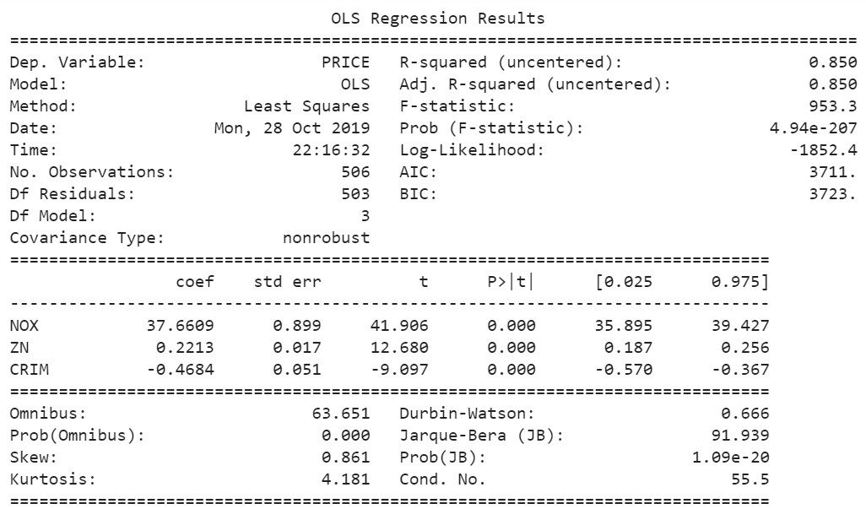

Slide 5
Assumptions
Observations are independent and identically distributed
An example: The set of observations drawn from die throws
No independent variable is correlated with the error terms
Mathematically defined as conditional expectation E(ε|Xi) = 0
Error term observations are uncorrelated with each other term
Frequently a problem in time-series data, but can also occur here

Slide 6
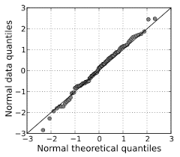

Assumptions
Residuals are normally distributed and have constant variance
We can check this by looking at either a residual plot or Q-Q plot
There is no multicollinearity (or perfect-collinearity)
Important to check for multiple linear regression case

Slide 7
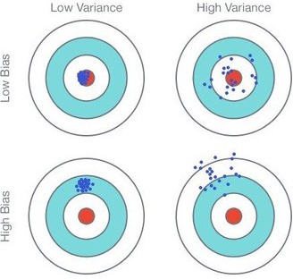
Bias-Variance Tradeoff
Recall our last lecture on bias-variance. This is useful to know for OLS assumptions, as we will cover cases when the coefficient estimates are biased and when they are off!
For example, having the regressor correlated with the error term produces bias in the coefficient estimates, while missing relationships in the residuals affects the precision.
Notes:
For example, endogeneity produces bias in the coefficient estimates, while autocorrelation and heteroskedasticity affect the precision.

Slide 8
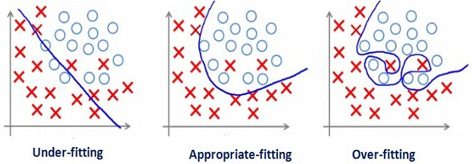
Bias-Variance Tradeoff
Of course, bias-variance tradeoff is also apparent in underfitting and overfitting the data (as we briefly introduced last lecture), but that topic will be left aside for later.

Slide 9
The Concept of IID
Suppose I throw a standard six-sided die and observe a value. I then repeat this process 10 times. What kind of distribution do I have for each throw? All throws?
In this case, a binomial distribution would be generated. Each random variable Xi is independent from the other Xi’s, and each Xi is identical to one another. Consider:
Xi ~ Uniform(7/2, 35/12) → Y ~ Binomial(35, 175/6)
* Don’t worry about the calculation needed to get the mean and variance. It is more important to realize that each Xi variable is independent and identically distributed.
** Fun fact: As number of throws approaches infinity, binomial converges to normal!

Slide 10
Endogeneity
Another way to say that an independent variable can predict residuals. When this type of correlation exists (go back to point 2), the coefficient estimates are biased!
One reason this assumption may be violated may be due to omitted variable bias. If the equation y = β₀ + β₁x₁ does not include a statistically significant variable x₂, then:
 | Positive Correlation of X₁,X₂ | Negative Correlation of X₁,X₂
Positive Correlation of X₁,Y | Overestimate β₁ | Underestimate β₁
Negative Correlation of X₁,Y | Underestimate β₁ | Overestimate β₁

Slide 11
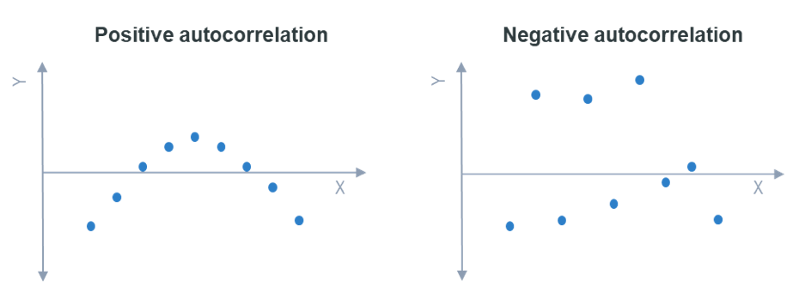
Autocorrelation
Another way to say that each residual observation predicts the next observation.
Durbin-Watson < 2
Durbin-Watson > 2

Slide 12


Autocorrelation
Serial correlation reduces the precision of OLS estimates. How can we solve this?
1) We can transform the data. For instance, If we have positive autocorrelation that looks like the figure on the left, we can take the square root to obtain the linear fit.
2) Alternatively, we could add a quadratic term to more appropriately fit the model.

Slide 13
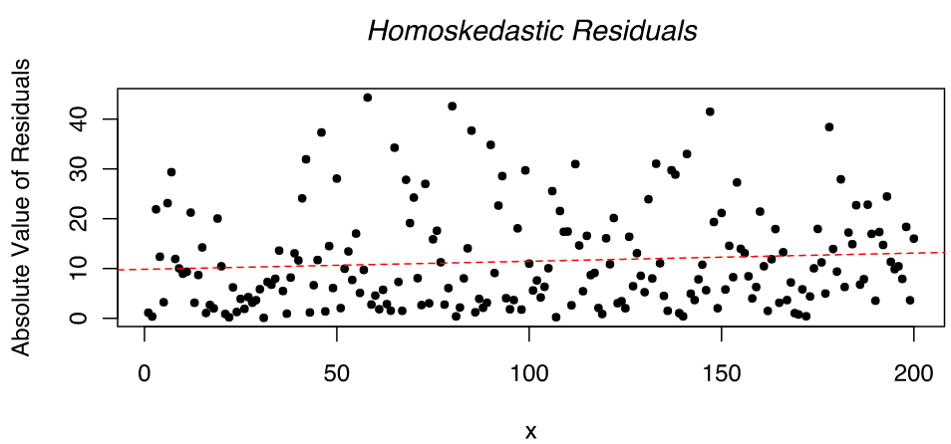
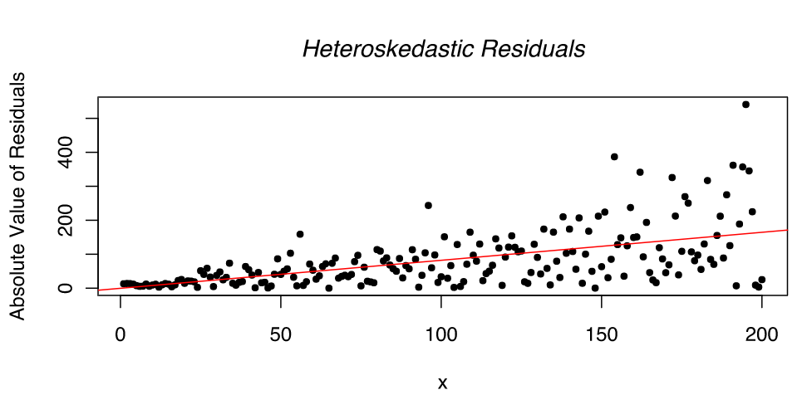
Heteroskedasticity
Another way to say that the residuals do not have constant variance. For a OLS fit, you want homoskedasticity, not heteroskedasticity. Refer below for example plots:

Slide 14
Heteroskedasticity
While heteroskedasticity does not cause bias in the coefficient estimates, it does make them less precise. Lower precision increases the chance that the coefficient estimates are further from the correct population value (refer to bias-variance slide).
Heteroskedasticity produces smaller p-values than they should be. Why? The OLS procedure does not detect the increase in the variance of coefficient estimates, so t-values and F-values are calculated using an underestimated amount of variance.
There are multiple ways to approach heteroskedasticity. See the next slide for a list.

Slide 15
Heteroskedasticity
Use heteroskedasticity-consistent standard errors. These errors are said to be robust (efficient and resistant to outliers) and are larger than their counterparts.
Use weighted regression. The idea is to give smaller weights to observations associated with higher variances to shrink their squared residuals. Note that it is important to assess the standardized residuals in this case. (Example: 1/SD²)
Transform the dependent variable. Like in the autocorrelation scenario, this will produce residuals that fit the required assumption(s) necessary for OLS model.

Slide 16


Box-Cox Transformation
A great way to transform your data is the box-cox transformation. Specifically, it is a family of transformations that include the log, square root, and more. The model is:
Lambda ranges from -5 to 5, and can be used for either positive or negative data.
Once your data is transformed, it is important to note that your interpretation of the model is now different. Make sure that your interpretation of your model is correct!
OR

Slide 17
Multicollinearity
Another way to say that the independent variables X₁, …, Xₙ are linearly associated. One way to check for multicollinearity is the VIF score calculated for each variable.
Variance Inflation Factor is calculated as VIF = 1 / (1 - R²), where the VIF statistic is different for each variable (i = 1, …, n). For instance, if i = 1, the equation would be:
X₁ = α₀ + α₂X₂ + … + αₙXₙ
A rule of thumb is that If the calculated VIF is greater than 10, Xi is said to have high multicollinearity with the other variables. Hence, Xi is dependent - not independent!

Slide 18
Multicollinearity
Structural multicollinearity occurs when we create a model term using other terms. For example, the regression y = β₀ + β₁x + β₂x² has a correlation between X and X²
Data multicollinearity occurs when it is present in the data rather than in the model. Observational experiments are more likely to possess this type of multicollinearity.
It is important to assess which type of multicollinearity we have, as it enables us to approach the problem appropriately. We will talk about how to deal with it shortly.

Slide 19
Multicollinearity
Multicollinearity reduces the precision of the estimate coefficients, which weakens the statistical power of the regression model. The p-values may be poor indicators of independent variables that are statistically significant, since the coefficients are sensitive to small changes in the model.
Fortunately, multicollinearity only affects the specific independent variables that are correlated. This means that if multicollinearity is not present in the variables you are interested in, you may not need to resolve it!

Slide 20

Multicollinearity
Multicollinearity also has no impact on predictions nor goodness of fit. Two models with and without multicollinearity (all else constant) will have the same R², adjusted R², predicted R², and regression standard error, so no changes may be necessary.

Slide 21
Multicollinearity
If we only have structured multicollinearity, one approach is to center the variables. This is also known as standardizing, or the process of putting different variables on the same scale. It typically subtracts the mean and divides by its standard deviation
If there is severe multicollinearity in the data, other solutions are to remove some of the highly correlated independent variables, linearly combine the variables (such as adding them), or perform an analysis (like PCA or partial least squares) designed for highly correlated variables. We will talk about model selection later.

Slide 22
How did we do?

Slide 24
Analysis Check
It looks like we violated the autocorrelation assumption, which states that the error terms are uncorrelated with the other error terms. Let us put in a squared term. We can then write our new model as y = β₀ + β₁x₁ + β₂x₁² + β₃x₂ + β₄x₃ where we have:
x₁ = NOX, x₂ = ZN, and x₃ = CRIM
Since we have x₁ and x₁² we will have structural multicollinearity in our model. This can be treated by standardizing, or subtracting the mean from all observed values.
With this, our new Durbin-Watson test statistic is about 2, and no other assumptions are violated. We have found an appropriate multiple regression model for our data!

Slide 25
Next Time
What if we wanted to determine which variables to include in our model? Is there a way to assess which variables are important, and which variables to leave out? Stay tuned for the next lesson, when we learn about subset selection!
We can use criteria such as adjusted R², Mallow’s Cp, and PRESS to help select our model. Although subset selection tends to overfit, it is easy to both understand and evaluate. We will later delve into more modern fitting methods.

